Slide 1

Team Safari Presentation – SMART Catalogue
Presented By : Shukri, Mohammed, Ahmad, Rashmi, and Tedi

Slide 2

Project Philosophy
The SMART website allow users to retrieve genomic, clinical and functional datapoints from genetic variants associated with the autoimmune disease Type 1 Diabetes (T1D) on chromosome 6 of the Homo Sapien genome.
It also helps in answering biological questions by visualising the data through the Manhattan plot and the linkage Disequilibrium heatmap it generates.
Researchers can query the website by entering SNP ID, genomic location and/or co-ordinate, genomic region or gene name.

Slide 3

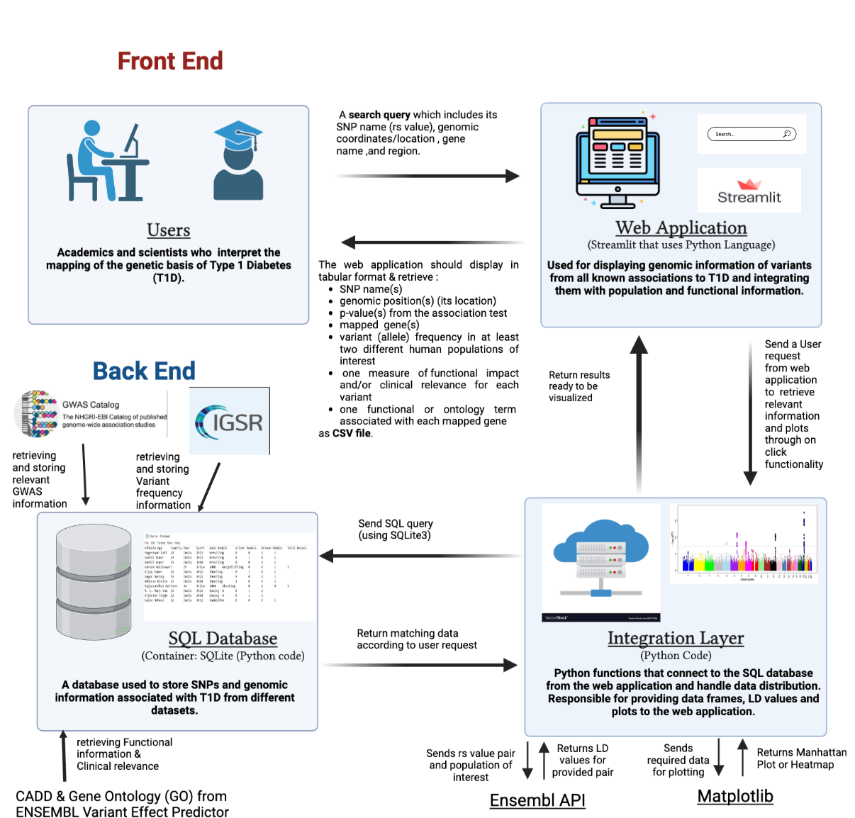
Software Architectual Diagram

Slide 4
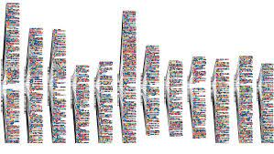


Data Gathering From EBI
Various websites were explored to obtain the relevant data sets required to construct a relational database in SQLite.
The EBI’s Genome Wide Association (GWAS) Catalogue was used to obtain genomic information of variants from all known association to Type 1 Diabetes (T1D).
This includes necessary information on the reported trait, significant SNP-trait associations, and sample metadata
The search term used to select the dataset was ‘type 1 diabetes mellitus’ and the MONDO_0005147 entry was used to download the Catalogue data as a TSV file.

Slide 5
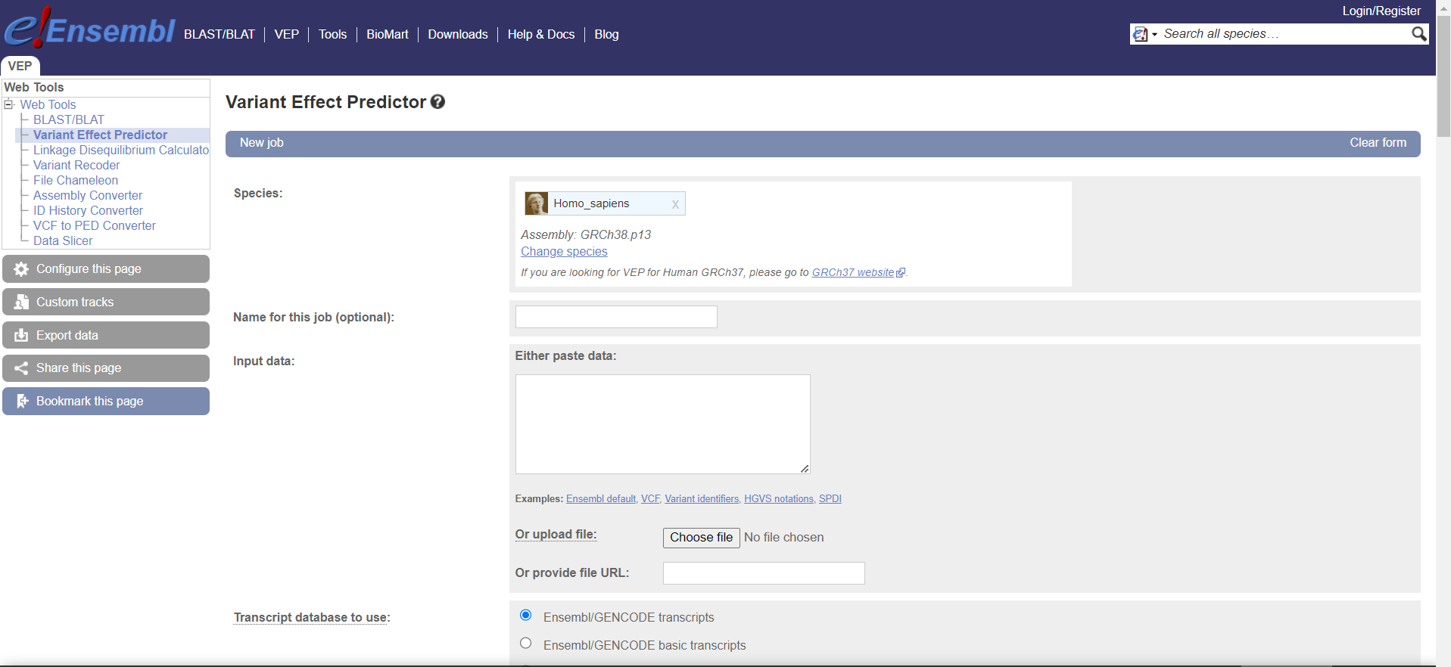


Gathering Other Datasets
The GWAS datasets downloaded was then viewed in python as Pandas' data frame to extract necessary information such as RS-IDs.
The information was necessary to obtain information like Gene Ontology (GO) terms, as well as SIFT, Polyphen, and CADD scores.
This was done through a website tool called Ensembl’s Variant Effect Predictor.
Additionally, datasets including variant frequency and population genetic data required to calculate LD values was obtained from a website called the International Genome Samples Resource after the search term 'type 1 diabetes' was included.

Slide 6
Why use SQLite?
Can handle large amounts of information
Easily create and query relational databases
Embedded in Python3
Better file organization
Does not require external servers
Notes:
Relational databases are important when having large amounts of data as it allows for better organization of data as well as being able to make it easy to query. Querying large relational databases can have varying levels of complexity and can lead to the recovery of large amounts of data.
Because it does not require a server, it allows the relational database to be deployed with the website as one package, without having to use an external server.

Slide 7
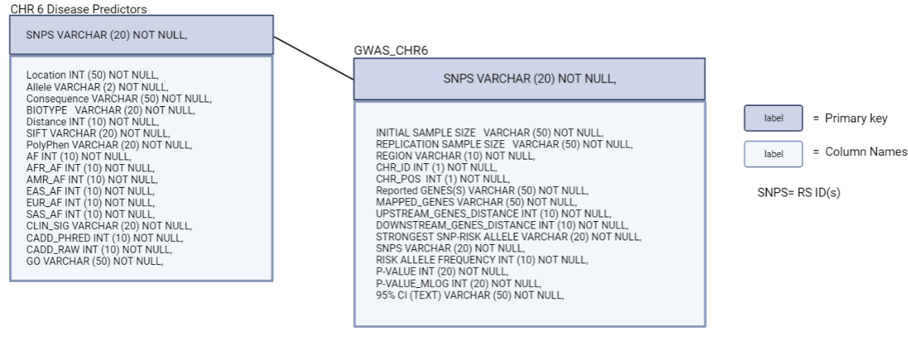
Database Schema
Notes:
2 tables in the sqlite database, connected via rs ids (SNPS) for gwas and (SNPS1) for chr6 extra information. Connected via rs ids for consistency due to the fact that the same rs ids from the gwas table were inputted into the VEP to acquire the extra genomic information.

Slide 8
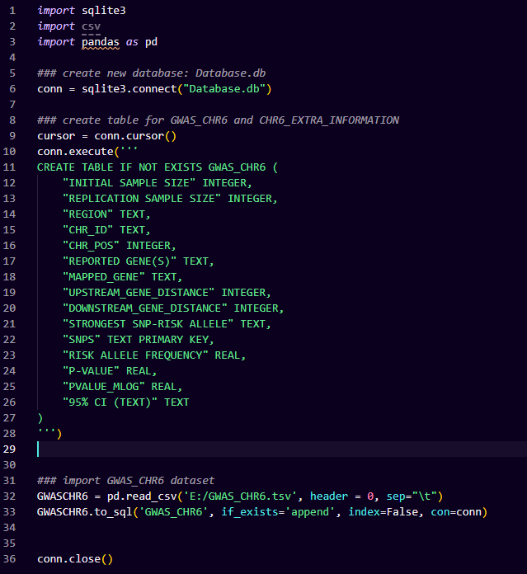
Creating the Database
Using Pandas and SQLite 3
Notes:
As mentioned before a benefit of using SQLite is the fact that it is embedded in python so creating the database is very easy and can implemented in a single python workflow. Importing tables from a tsv file is made simpler using the pandas python package which automatically fills in the empty table in the database without extra lines of code.

Slide 9
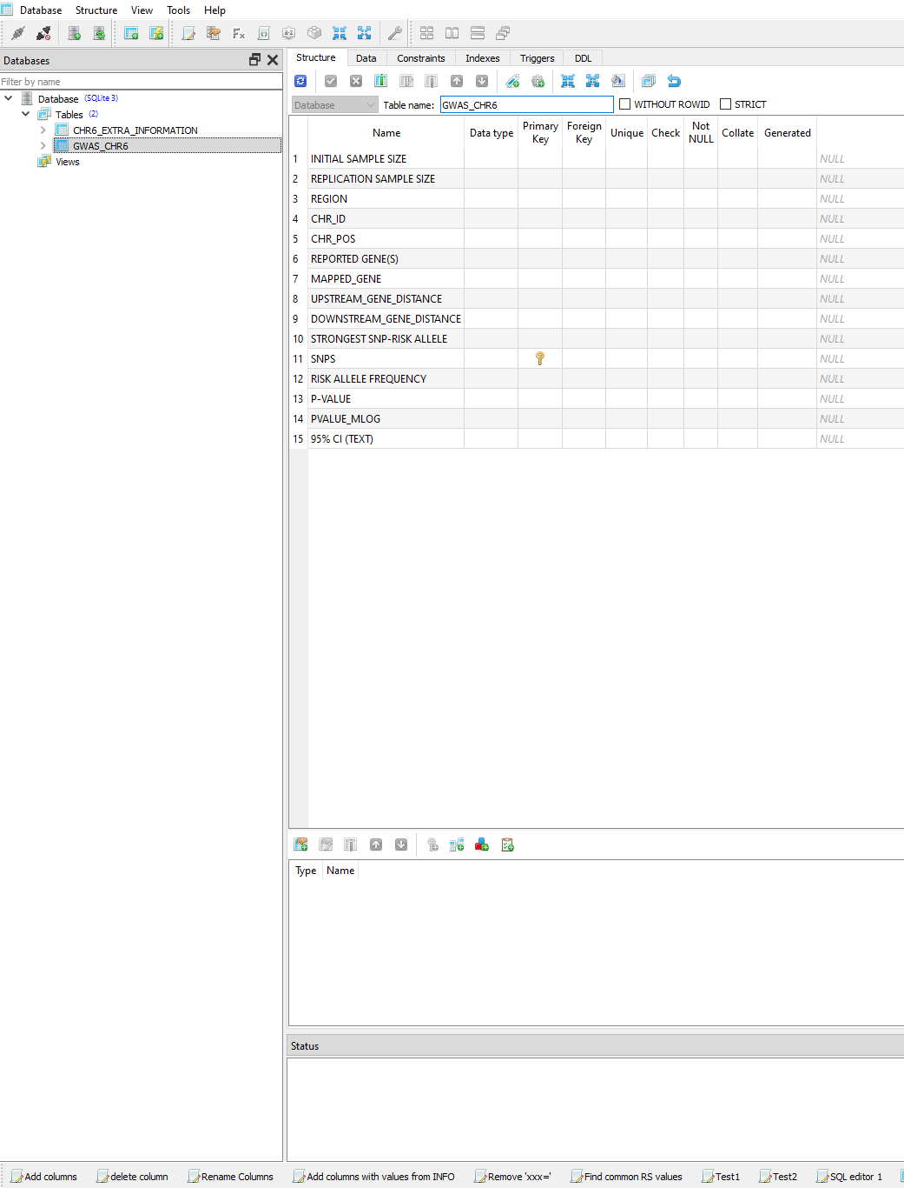
SQLiteStudio
2.
1.
3.
4.
Database explorer
Tool bar
Database structure
Set primary/foreign keys
SQLite editor
5.
Notes:
Manage and view databases
Toolbar allows for different options and settings such as being able to import/export datasets and databases
Can decide on the type of values, by default sqlite studio stores numbers as strings, so its important to specify whether the values are integers, floats, or text
Set primary and foreign keys at the click of a button
Sqlite editor allows for use of sql code for fine-tuning data and manipulating values stored in columns. Renaming, separating, adding, deleting, and much more.

Slide 10
Website
SMART T1D Variant Catalogue * Shukri, Mohamed, Ahmad, Rashmi & Teodora

Slide 11
Intergration Layer
SMART T1D Variant Catalogue * Shukri, Mohamed, Ahmad, Rashmi & Teodora

Slide 12
Calculating Linkage Disequilibrium
Integration layer
Function #2
Ensembl API
Calculate LD for RS value pair
Function #1
Calculate LD for a list of RS values
Map database populations to Ensembl ancestries
Function #3

Slide 13
Limitations & Opportunities for Development
SMART T1D Variant Catalogue * Shukri, Mohamed, Ahmad, Rashmi & Teodora

Slide 14
Limitations
Opportunities for development
Greater allele frequency data in the European population in comparison to other populations.
Database only limited to chromosome 6
Missing data for some of the variants
Expansion of database to cover all chromosomes
The chatbot feature of the website could be more website-specific
Log-in feature would allow users to keep a record of previously downloaded data

Slide 15
Thank you for listening . Questions?
SMART T1D Variant Catalogue * Shukri, Mohamed, Ahmad, Rashmi & Teodora

